Slide 1
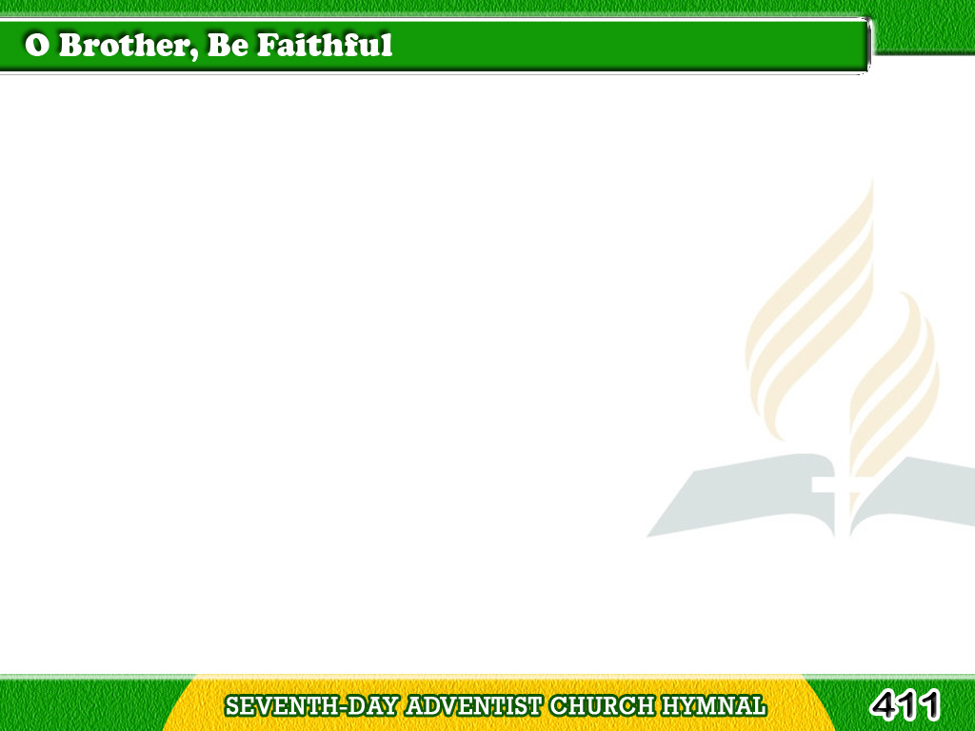
1/4
O brother, be faithful!
soon Jesus will come,
For whom
we have waited so long;
Tagalog
Version

Slide 2
1/4
O, soon we shall enter
our glorious home,
And join in the conqueror’s song.
Tagalog
Version

Slide 3
1/4
O brother, be faithful!
for why should we prove
Unfaithful to Him
who hath shown
Tagalog
Version

Slide 4
1/4
Such deep, such unbounded
and infinite love
Who died to redeem us Him own.
Tagalog
Version

Slide 5
2/4
O brother, be faithful!
the city of gold,
Prepared for the good
and the blest,
Tagalog
Version

Slide 6
2/4
Is waiting its portals
of pearl to unfold,
And welcome thee into thy rest.
Tagalog
Version

Slide 7
2/4
Then, brother, prove faithful!
not long shall we stay
In weariness here, and forlorn,
Tagalog
Version

Slide 8
2/4
Time’s dark night of sorrow
is wearing away,
We haste to the glorious morn.
Tagalog
Version

Slide 9
3/4
O brother, be faithful!
He soon will descend,
Creation’s omnipotent King,
Tagalog
Version

Slide 10
3/4
While legions of angels
His chariot attend,
And palm wreaths,
of victory bring.
Tagalog
Version

Slide 11
3/4
O brother, be faithful!
and soon shalt thou hear
Thy Savior pronounce
the glad word,
Tagalog
Version

Slide 12
3/4
Well done, faithful servant,
thy title is clear,
To enter the joy of thy Lord.
Tagalog
Version

Slide 13
4/4
O brother, be faithful!
eternity’s years
Shall tell for thy faithfulness now,
Tagalog
Version

Slide 14
4/4
When bright smiles of gladness
shall scatter thy tears,
A coronet gleam on thy brow.
Tagalog
Version

Slide 15
4/4
O brother, be faithful!
the promise is sure,
That waits
for the faithful and tried;
Tagalog
Version

Slide 16
4/4
To reign with the ransomed,
immortal and pure,
And ever with Jesus abide.
Tagalog
Version

